Slide 1

Remember to…
Sign in on the app (at home and in class)
Wipe your desk before and after use (if you are in the class / on campus)
Connect your phone to eduroam to help our internal track and trace ☺ (if you are on campus)

Slide 2

BS1220: Introduction to Software Design and Development
Week 4 – Hybrid Session 1

Slide 3

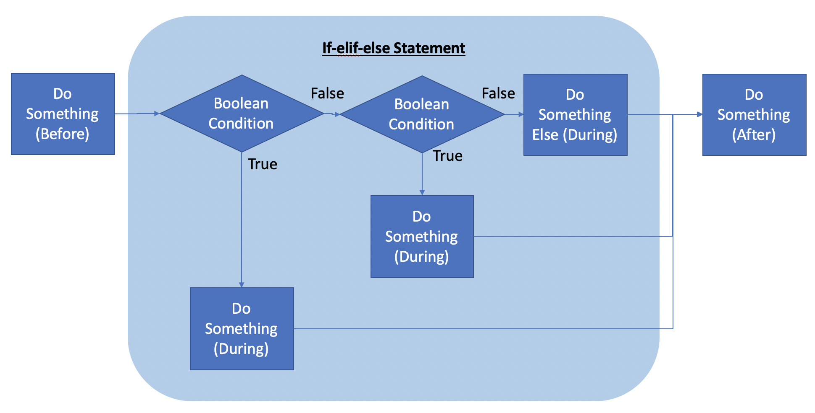
4.9: If-elif-else

Slide 4

Demo
Developing if-else if-else statements

Slide 5
Your Turn
Adapt your payday program so that when Thursday is entered by the user it outputs:
“It’s nearly payday – one more sleep!”

Slide 6

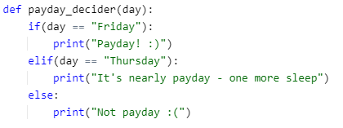
Solution

Slide 7
4.10: Pass Keyword
A dummy placeholder
Used where there is a syntactical requirement in the language
Can be used as a placeholder for future code
Essentially does nothing
Notes:
Empty code is not allowed in loops, function definitions, class definitions, or in if statements. Therefore, if there is a situation where we don’t want to write the code yet (or even if there is no code for the construct), we need a way of avoiding this. We use the pass keyword for this. When the pass statement is executed, nothing happens, but you avoid getting an error when empty code is not allowed.
In other words, the pass statement is simply ignored by the Python interpreter and can be seen as a null statement. When the pass is executed, nothing happens.

Slide 8

Demo
Using the pass statement

Slide 9
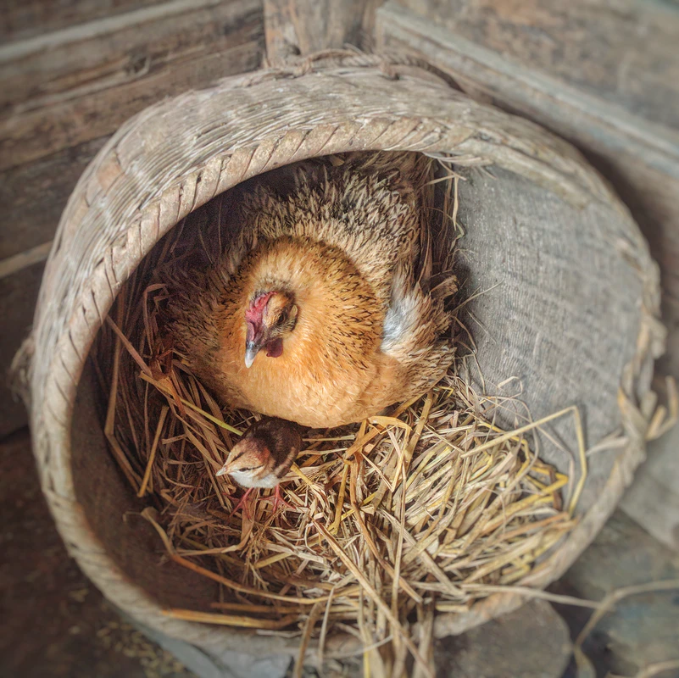
4.11: Nesting
Placing control structures within other control structures
E.g. if statement inside another if statement
Allows for powerful relatively simple programming

Slide 10
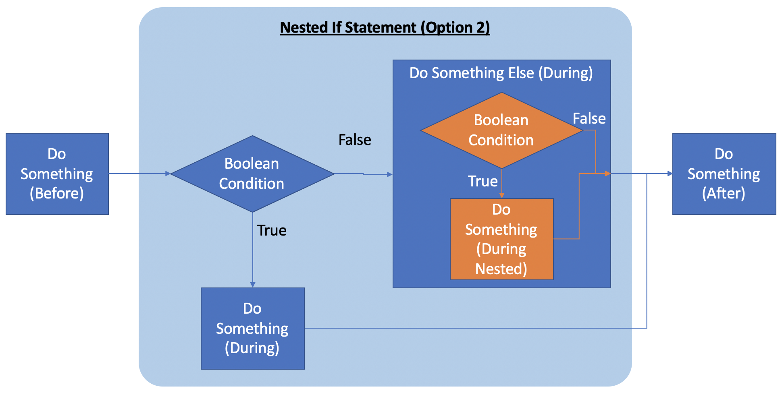
Nested If

Slide 11
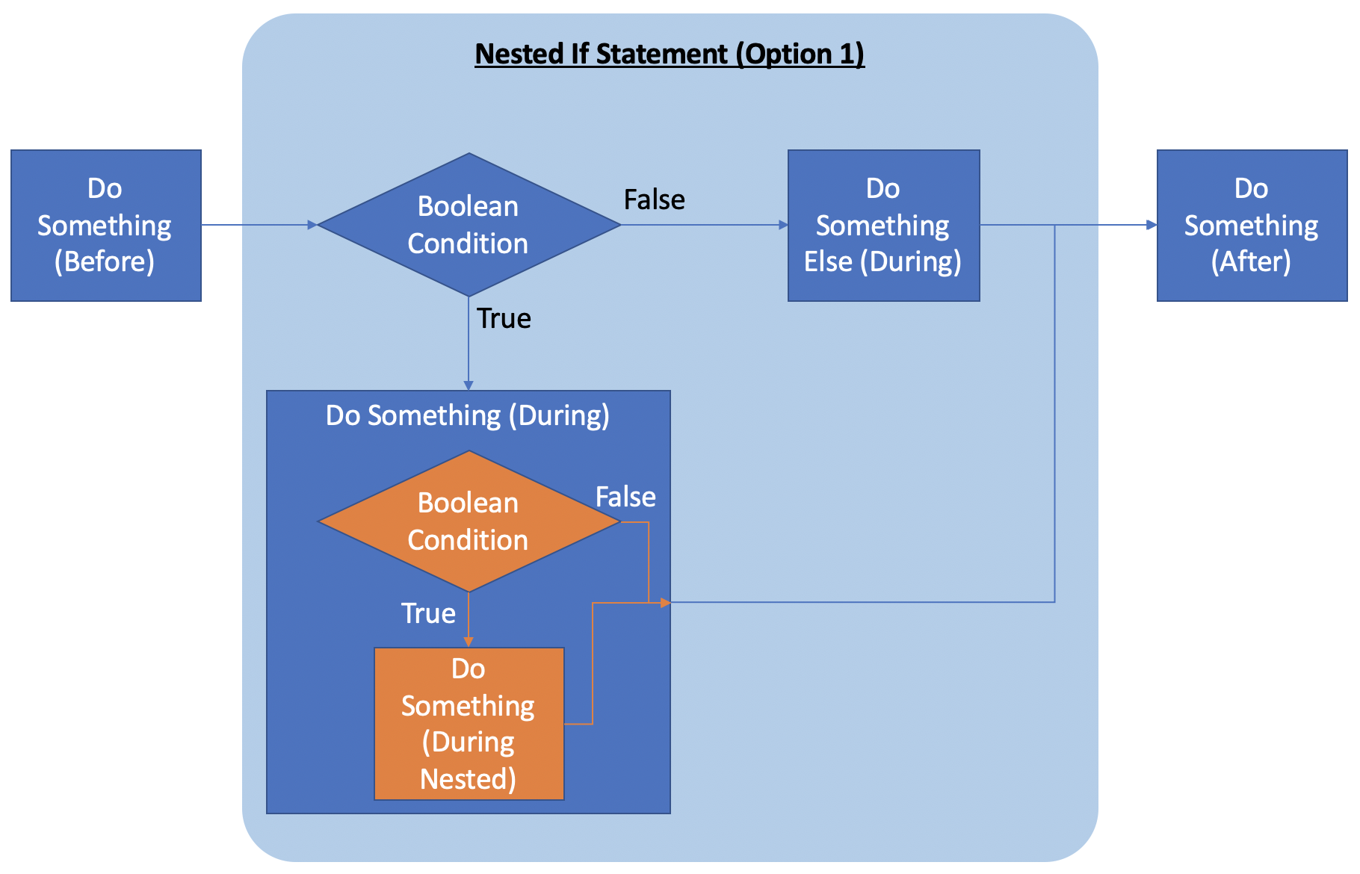
Nested If

Slide 12

Demo
Nesting If Statements

Slide 13
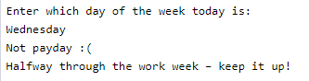
Your Turn
Using a nested if statement, adapt your program so that if Wednesday is entered, the following is output AFTER it says that it isn’t payday:
“Halfway through the work week – keep it up!”

Slide 14
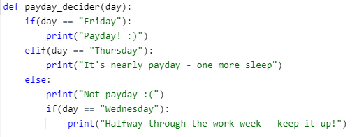
Solution

Slide 15
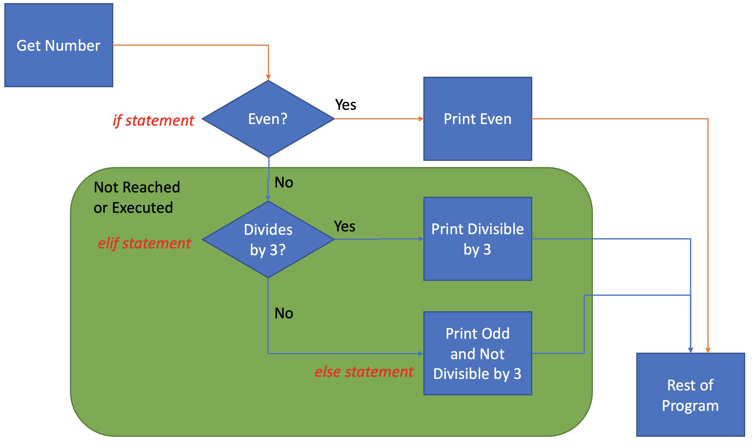
Fixing our Demo Program (From before Nesting)

Slide 16
Using Boolean Operators
In session 1, we talked about Boolean Operators:
AND
OR
NOT
E.g. to establish whether a number is between 5 and 10 (inclusive) with Python we would use:
x >= 5 and x <= 10
Error regularly encountered is:
x>= 5 and <=10

Slide 17

Demo
Using Boolean operators in if statements

Slide 18
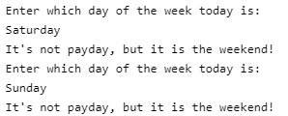
Your Turn
Adapt your program so that if Saturday or Sunday are entered is says:
“It’s not payday, but it is the weekend!”

Slide 19
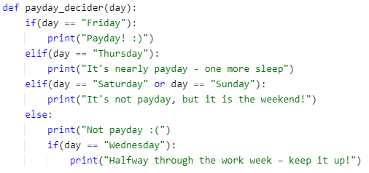
Solution

Slide 20
Activity Decider
Monday
Back to Uni
Tuesday
Cook Dinner for your Flatmates
Wednesday
Hump Day - Go to the Gym!
Thursday
Cook Dinner for your Flatmates
Friday
Party Time!
Saturday
Time to Chill and Watch a Movie
Sunday
Time to Chill

Slide 21
4.12: Summary of This Week
To understand what a control structure is and the three different types in programming
To consider the benefits and drawbacks of each type of control structure
To define the purpose of the selection control structure
To outline the types of selection control structure both in programming and in Python
To understand and use Boolean Operators
To implement the main types of control structure within Python
To execute functions which require nested selection control structures
To understand the pass keyword in Python

Slide 22
Next Week
Pre-Session Materials
Types of Loop in Programming
The range() function
The for loop in Python (using range())
Hybrid Session 1
For-each loop in Python (using lists)
While loop in Python
Hybrid Session 2
Nested loops
Nesting control structures (selection within a loop)
Validating user input
The break and continue keywords

